Slide 1
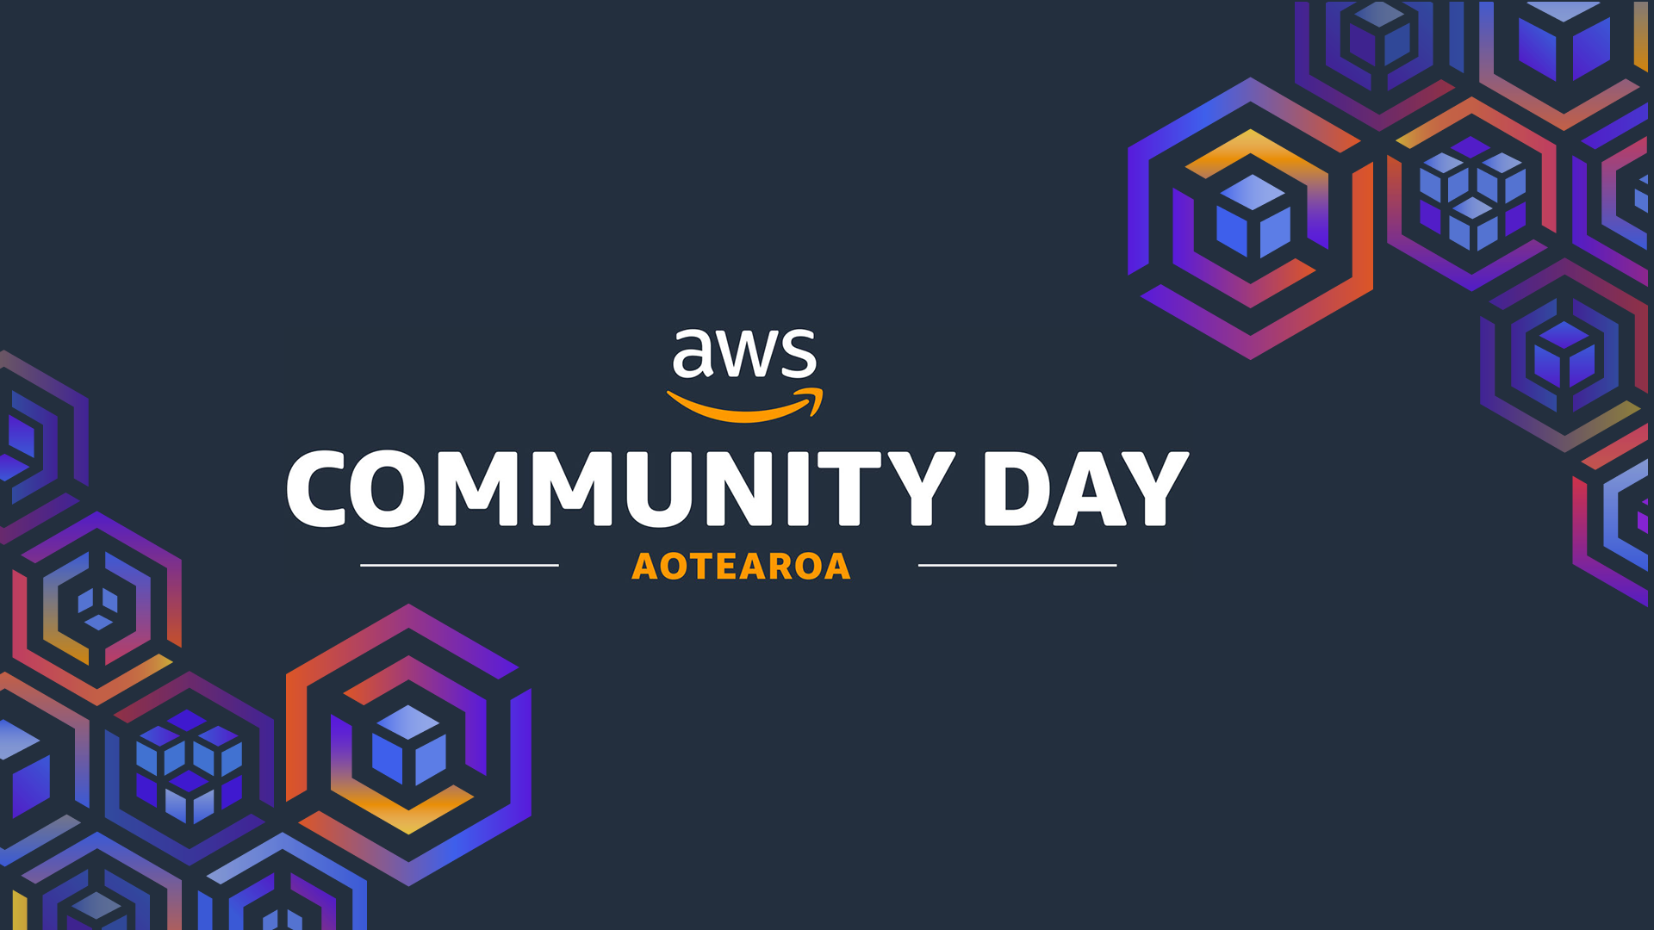

Slide 2



Amazon VPC Lattice: When to Use It and When to Skip It
John Ajera | 18th Sep 2025 Platform Engineer
Earth Sciences New Zealand
Session Resources

Slide 3
Agenda
Introduction
Overview
How VPC Lattice Works
When to Use It and When to Skip it
Demo

Slide 4
Introduction

Slide 5
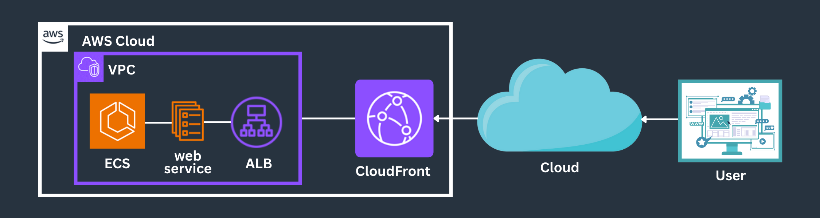
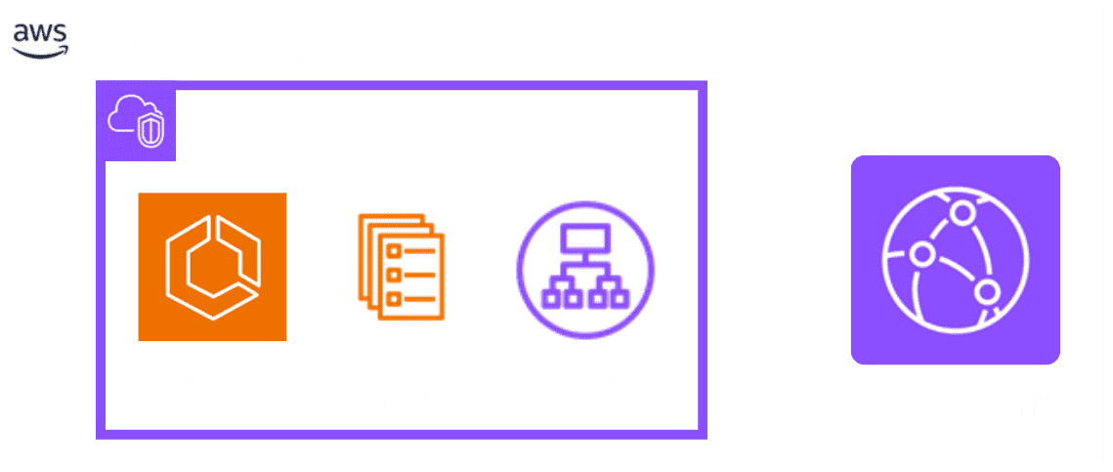
What is an Amazon VPC?
VPC is the foundational network environment for your AWS resources.
Introduction

Slide 6
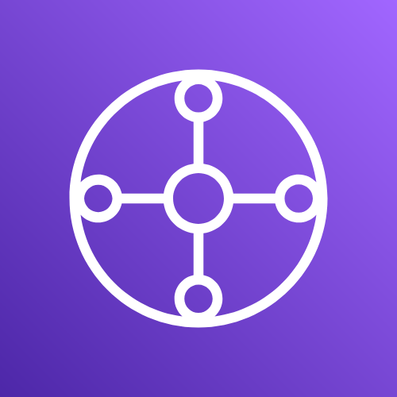
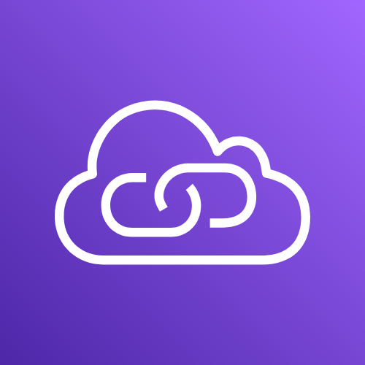

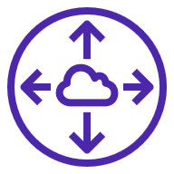
Common Inter VPC Connectivity
VPC Peering
Transit Gateway
PrivateLink

Slide 7
Overview

Slide 8

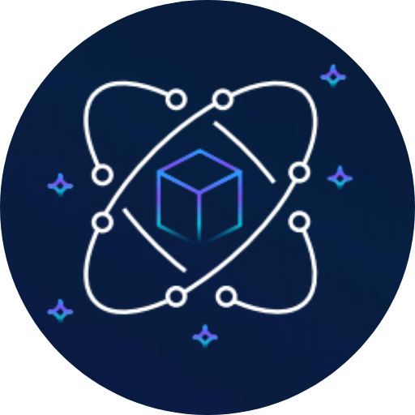
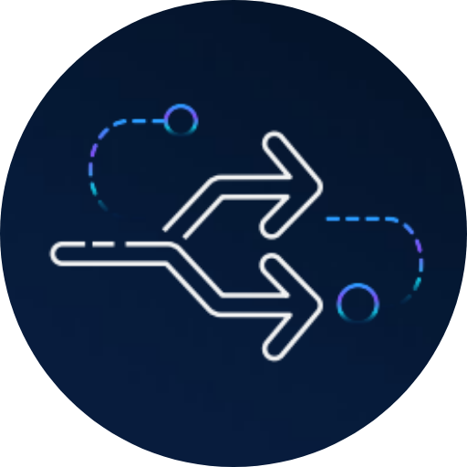
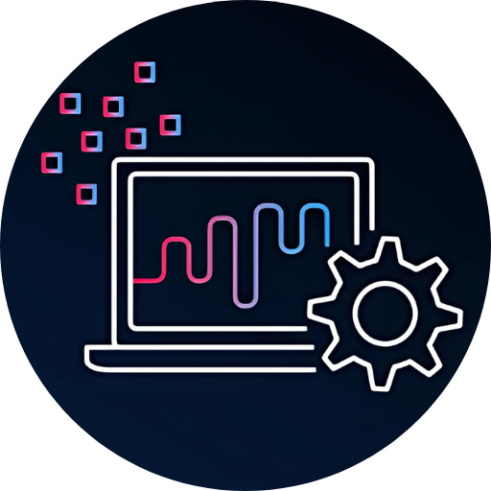
VPC Lattice Overview
No sidecar proxies required
Fully managed control plane with no proxies to deploy and maintain
Works across all compute options
Amazon EC2, Amazon EKS, Amazon ECS, and AWS Lambda
Unified traffic and
access controls
Improved security posture
and rich traffic controls
and segmentation
Integrates with existing
network connectivity
You can choose what
services are accessible
through VPC Lattice
Notes:
Simplifies application layer networking

Slide 9
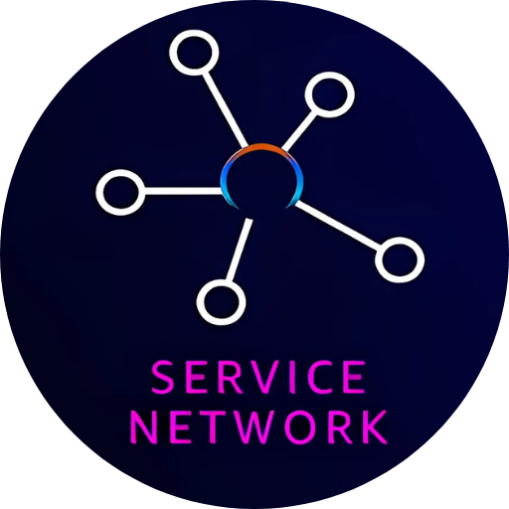
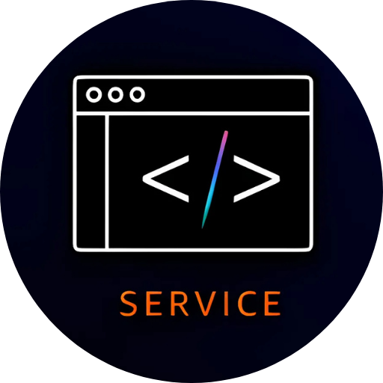


Four Main Components of VPC Lattice

Slide 10
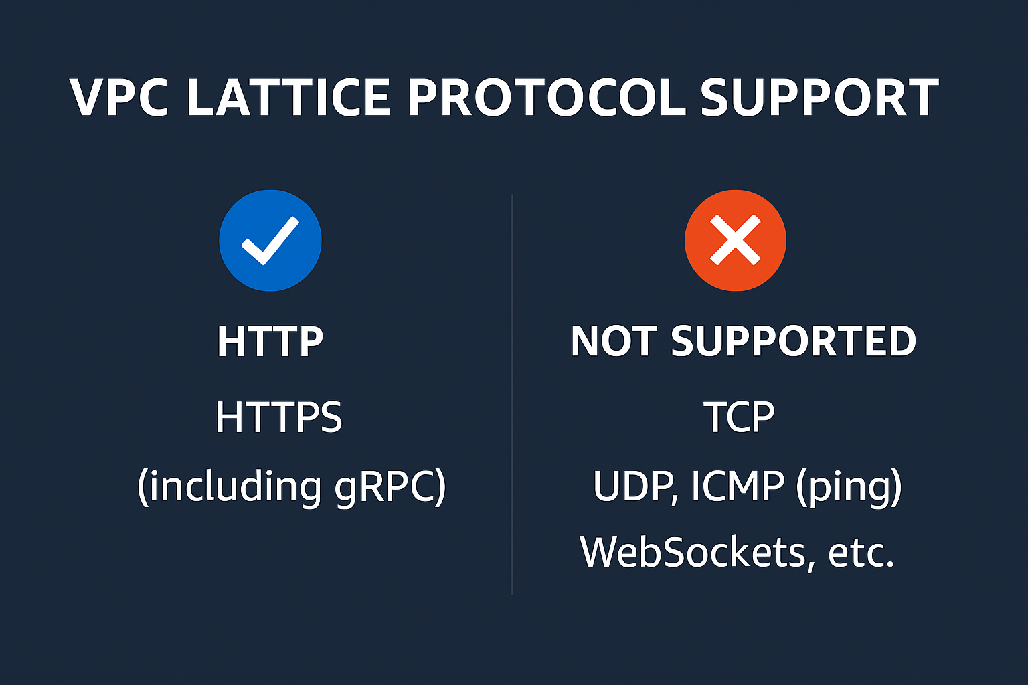
Protocol Support
Amazon VPC Lattice is an application-level (Layer 7) service networking solution.

Slide 11

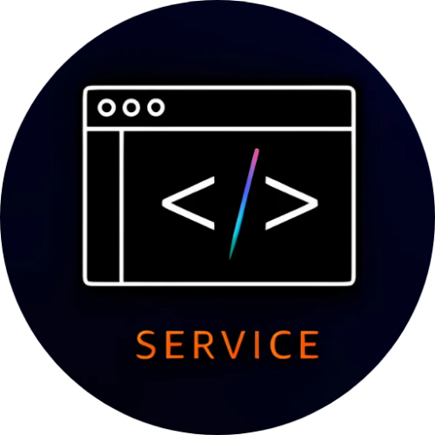

How to Access VPC Lattice
Virtual private cloud (VPC)
VPC
> Lattice: Service networks
PrivateLink and Lattice
Service networks
Lattice services
Target groups

Slide 12
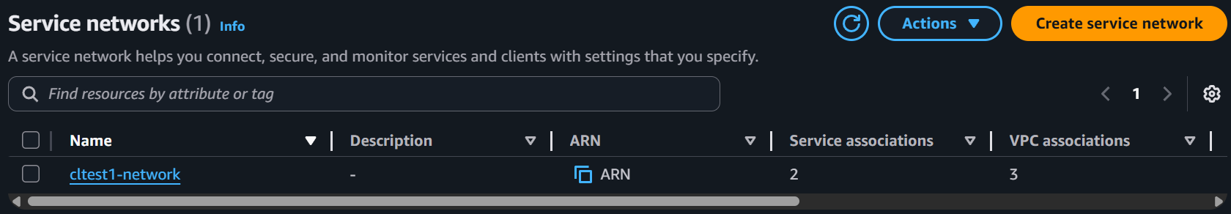
How to Access VPC Lattice – Service Networks

Slide 13
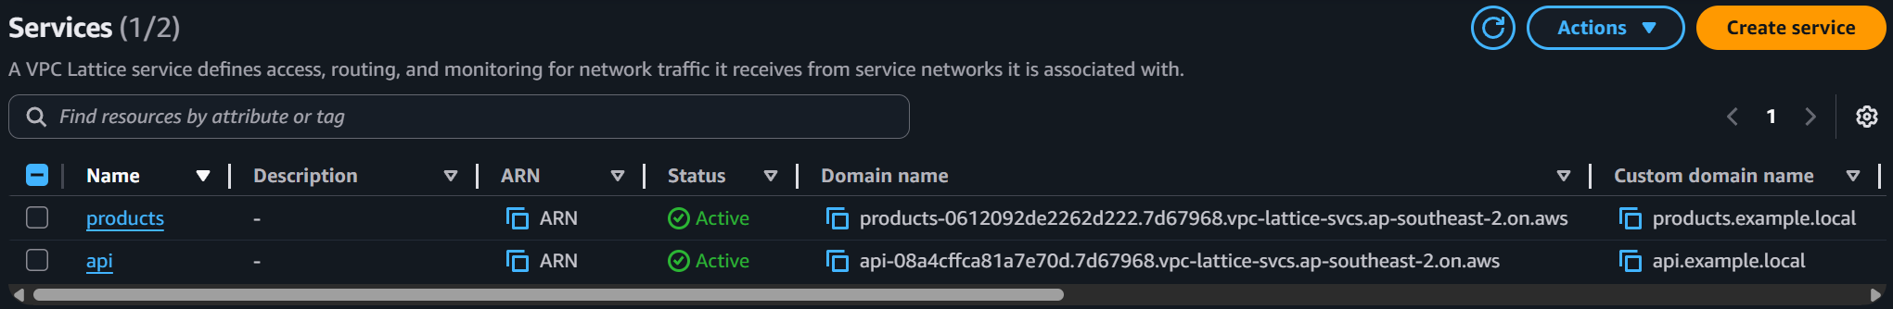
How to Access VPC Lattice – Services

Slide 14
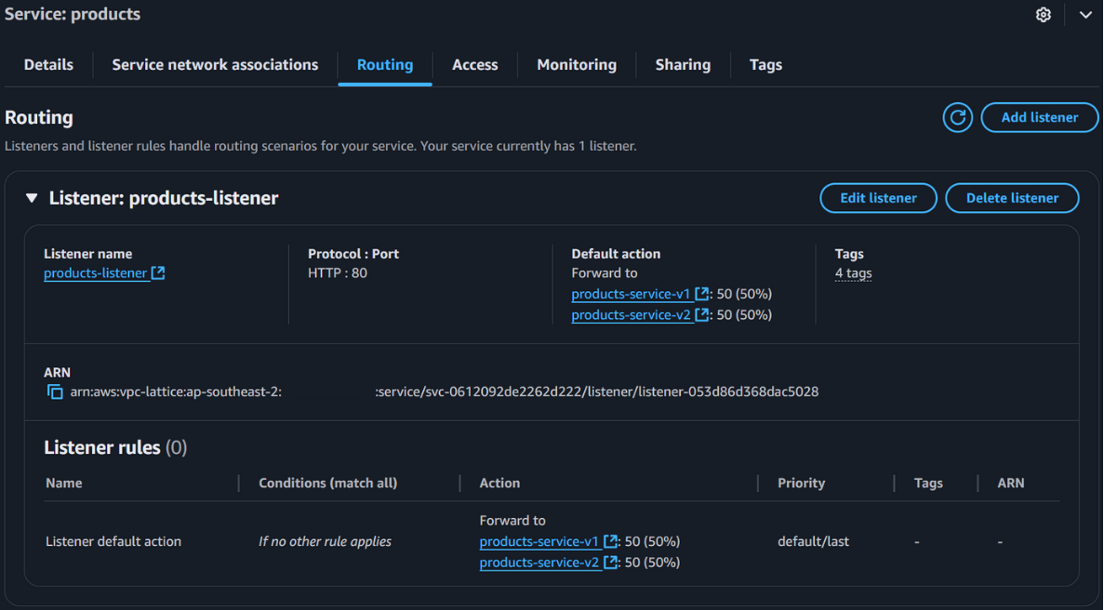
How to Access VPC Lattice – Service Routing

Slide 15
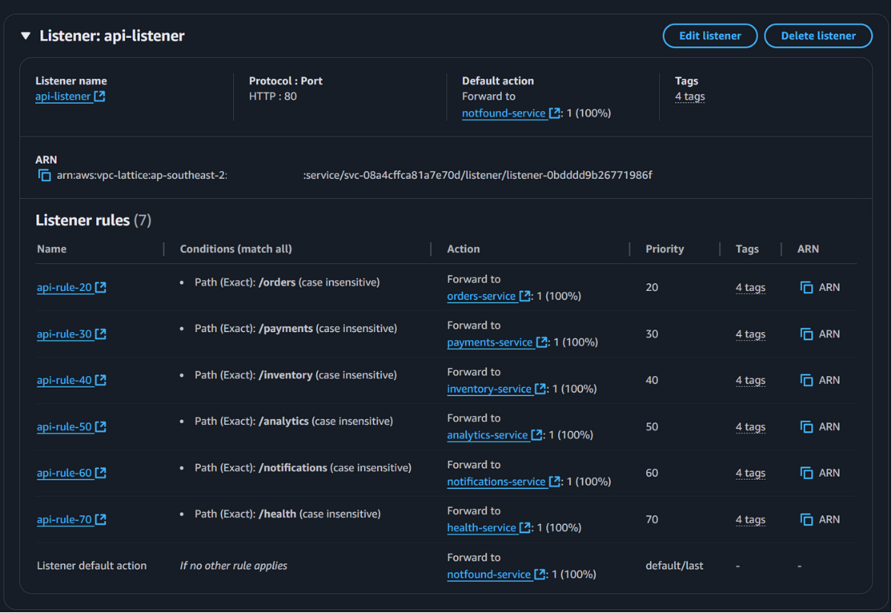
How to Access VPC Lattice – Service Routing

Slide 16
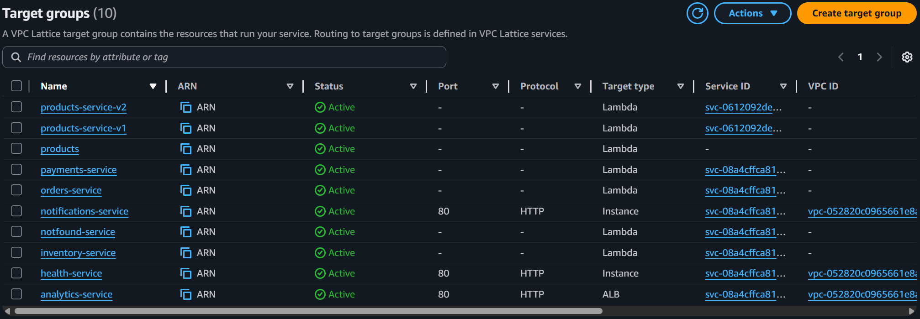
How to Access VPC Lattice – Target Groups

Slide 17
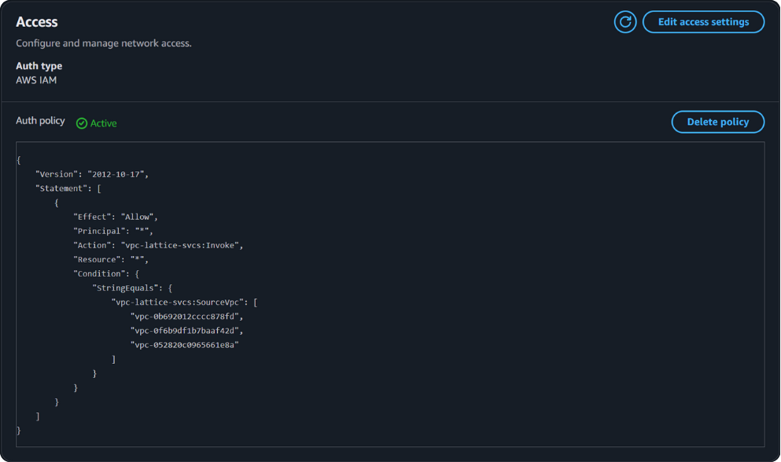
How to Access VPC Lattice – Access

Slide 18
How VPC Lattice Works

Slide 19



Service Network Creation
Service network name
Service associations
Network access
VPC associations
Security
Group
None (Default)
VPC
cltest1-network
OR
<= 500
VPC
<= 500
IAM

Slide 20

Lattice Service Creation
Service name
api
Domain configuration
api-094c8bf788085afc8.7d67968.vpc-lattice-svcs.ap-southeast-2.on.aws
Custom domain name
api.example.local
Route53
Service access
Security
Group
OR
None (Default)
IAM

Slide 21

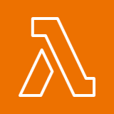




Example: api.example.local
/???
/health
/payments
/inventory
/notifications
/orders
/analytics
http://api.example.local
VPC 2
VPC 3
/orders (LAMBDA)
/payments (LAMBDA)
/inventory (LAMBDA)
/notifications (EC2)
not found (LAMBDA)
/health (IP target)
/analytics
(ECS – ALB)
Amazon
Route 53
Amazon VPC Lattice
api.example.local

Slide 22
Example: products.example.local
http://products.example.local
VPC 2
50%
products v1
traffic
Amazon
Route 53
Amazon VPC Lattice
50%
products v2
products.example.local

Slide 23
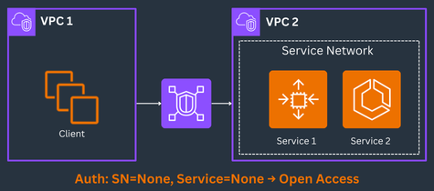
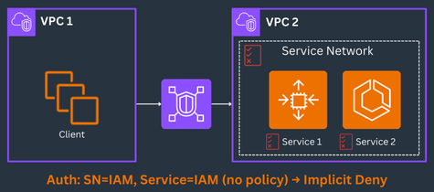

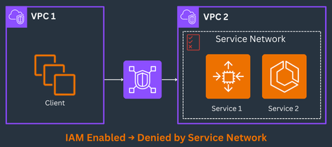
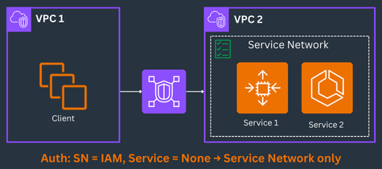
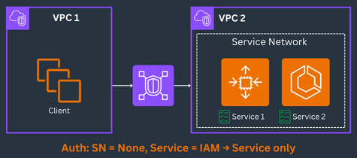
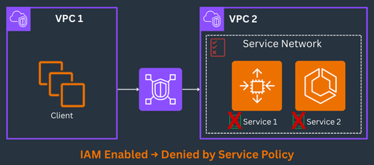

Amazon VPC Lattice – Auth & Policy Outcomes
1
2
3
4
5
6
7
8

Slide 24
Common Patterns

Slide 25
When to Use VPC Lattice
1. Multiple VPCs / Accounts – Need secure, consistent connectivity without VPC peering or TGW complexity.
2. Application-Layer Routing – Need to route by path/hostname (like /api, /orders) — similar to ALB or API Gateway, but across multiple VPCs/accounts without extra networking setup.
3. Mixed Target Types – Combine Lambda, EC2, ECS, ALB/NLB into a single logical service (no separate LBs per target type).
4. Centralized Auth & Policies – Use IAM + fine-grained policies to control who can call what at request level — built-in, no custom auth layer needed.
5. Service-to-Service Discovery – Simplify internal DNS and cross-VPC name resolution.
6. Private Connectivity – Services stay inside the AWS network — no public IPs or IGWs required.

Slide 26
When to Skip VPC Lattice
1. Single VPC & Simple Routing – Use ALB/NLB directly — Lattice adds unnecessary complexity here. 2. East-West IP Traffic Only – Lattice supports HTTP/HTTPS only — use TGW/peering for raw TCP/UDP. 3. Ultra-Low Latency / High Throughput – Adds a few ms of L7 overhead — not ideal for HPC or µs-sensitive apps. 4. Public-Facing APIs – Lattice is private-only; API Gateway/CloudFront are better for internet-exposed APIs. 5. Cost-Sensitive Bulk Transfer – Lattice charges per request + GB processed; TGW is cheaper for heavy L3 traffic.

Slide 27
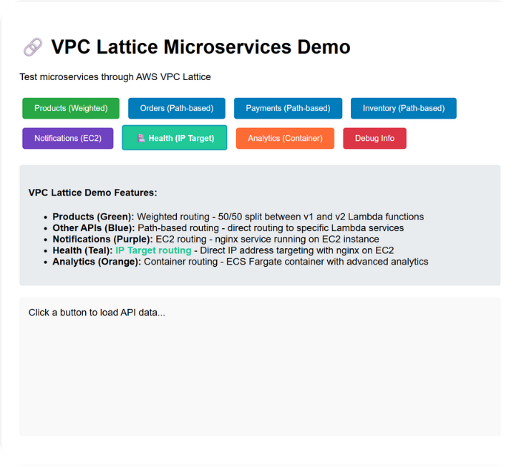
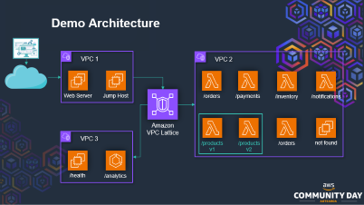
Demo

Slide 28
Examples
Terraform module: https://registry.terraform.io/modules/tfstack/vpc-lattice/aws/latest
Demo: https://github.com/jajera/aws-community-day-aotearoa-2025-vpclattice-talk

Slide 29

Feedback
Go to
pigeonhole.at
Enter passcode
AWSCDNZ25

Slide 30
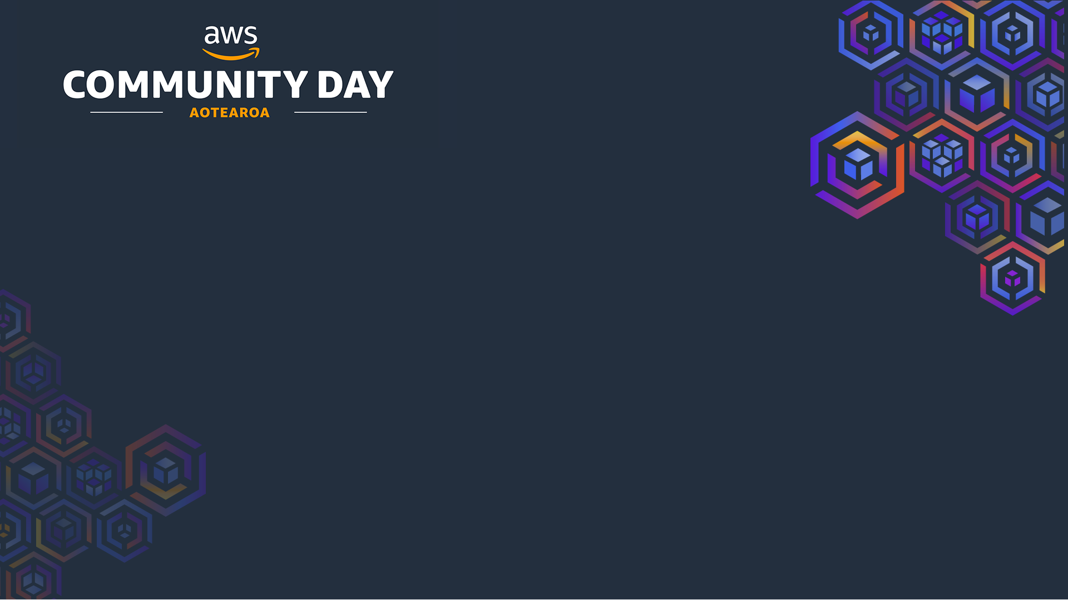
Appendix

Slide 31
VPC Lattice Components
Component | Purpose
* Service Network | Logical boundary for a collection of services and resource configurations
* Service | Independently deployable unit of software that delivers a specific task or function
Listener | Process that checks for connection requests and routes them to targets
Rule | Component of a listener that forwards requests to targets based on conditions
- Target Group | Collection of resources (targets) that run your application or service
Resource | Entity such as RDS database, EC2 instance, application endpoint, domain-name target, or IP address
Resource Gateway | Point of ingress into the VPC where resources reside
Resource Configuration | Logical object representing single resource or group of resources
* Service Directory | Central registry of all VPC Lattice services owned or shared via AWS Resource Access Manager (RAM)
* Auth Policies | Fine-grained authorization policies for service access control

Slide 32
Amazon VPC Lattice Reference Architectures
https://docs.aws.amazon.com/architecture-diagrams/latest/amazon-vpc-lattice-use-cases/amazon-vpc-lattice-use-cases.html

Slide 33
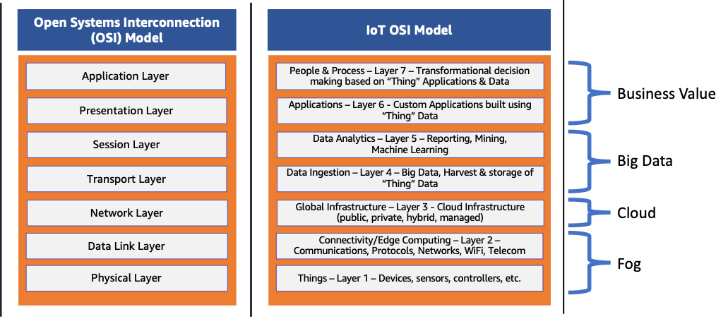
OSI Model
https://aws.amazon.com/what-is/osi-model/

Slide 34
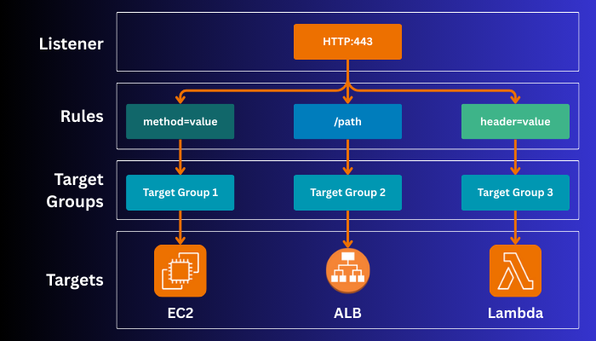
VPC Lattice: Service Components

Slide 35
Zoom Slides

Slide 36






Web Service on Amazon ECS
AWS Cloud
Availability Zone 1
Availability Zone 2
Virtual private cloud (VPC)
NAT gateway
Amazon ECS Auto Scaling
NAT gateway
ECS Service
Task X
Task X
Application Load Balancer
Amazon CloudFront (CDN)

Slide 37


Web Service on Amazon EC2
AWS Cloud
Availability Zone 1
Availability Zone 2
Virtual private cloud (VPC)
NAT gateway
Amazon EC2 Auto Scaling
NAT gateway
Auto Scaling group
Instance
Instance
Application Load Balancer

Slide 38

VPC Peering
VPC 1
Direct, one-to-one connection between two VPCs.
Simple and low-cost, but no transitive routing.
Works at layer 3 (network/ip) layer.
Peering connection
VPC 2
Peering connection
Peering connection
VPC 3

Slide 39

AWS Transit Gateway
VPC 1
Connects multiple VPCs through a single gateway.
Scales better, supports transitive routing, but adds cost.
Centralized hub-and-spoke model for many VPCs.
Works at layer 3 (network/ip) layer.
Transit Gateway
VPC 2
Transit Gateway
VPC 3

Slide 40
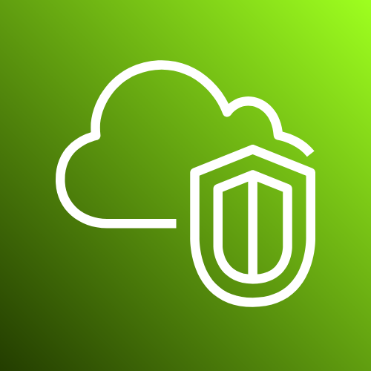



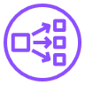
AWS PrivateLink
VPC 1
Secure, service-level connectivity between VPCs.
Exposes only specific services (via endpoints), not the entire VPC network.
Works at layer 4 (transport) layer.
Instances
Endpoints
VPC 2
Network Load Balancer
Instances
PrivateLink

Slide 41
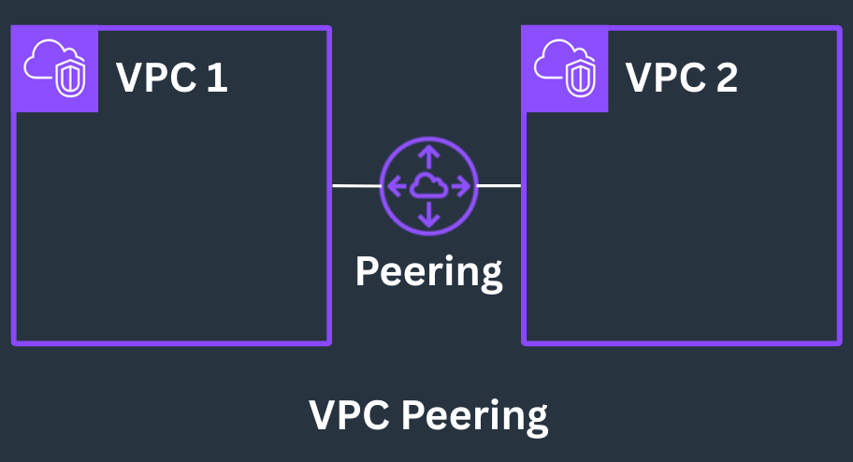
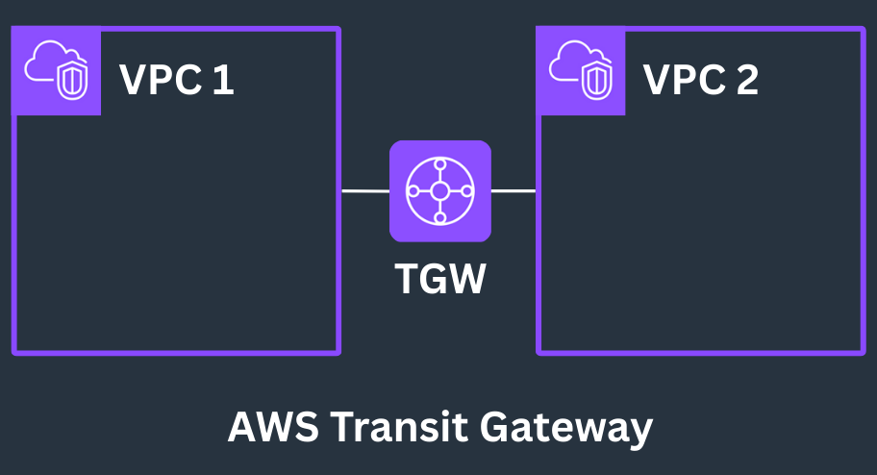
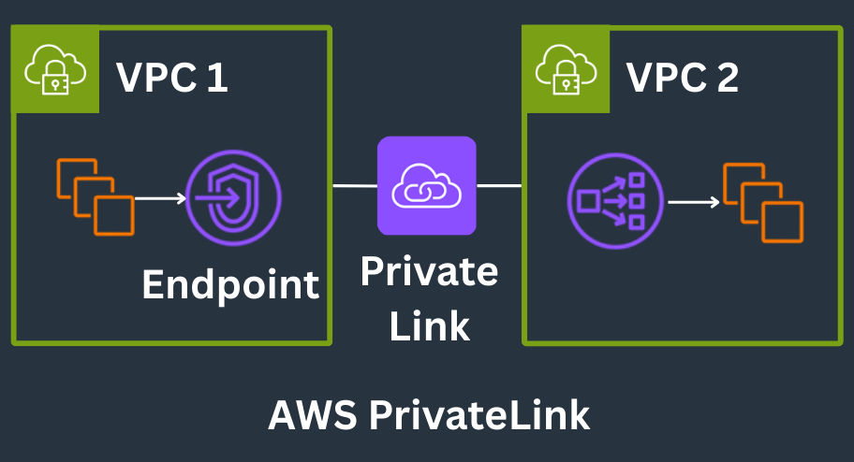
Common Inter VPC Connectivity
1
2
3
VPC Peering
- Direct, one-to-one connection between two VPCs.
- Simple and low-cost, but no transitive routing.
AWS Transit Gateway
- Centralized hub-and-spoke model for connecting many VPCs.
- Scales better, supports transitive routing, but adds cost.
AWS PrivateLink
- Secure, service-level connectivity between VPCs.
- Exposes only specific services (via endpoints), not the entire VPC network.

Slide 42
IAM Permission Example

Slide 43
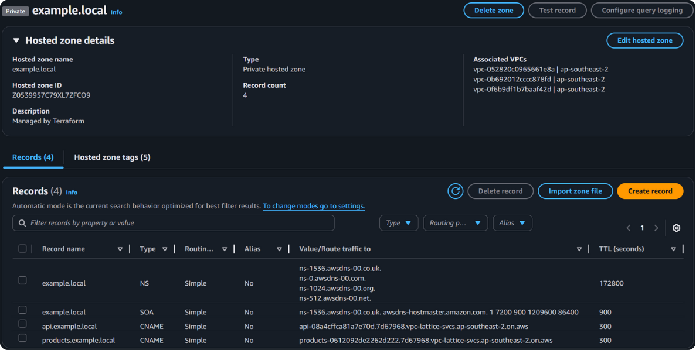
Route 53 Record Example

Slide 44


Demo Architecture
VPC 1
VPC 2
Web Server
Jump Host
/orders
/payments
/inventory
/notifications
Amazon VPC Lattice
VPC 3
/products
v1
/products
v2
/orders
not found
/health
/analytics

